Slide 1
Obesity Prediction Analysis
Presented by: Miro Zilaji

Slide 2
Agenda
Introduction
Dataset
Original Code
Developed Code
Challenges

Slide 3
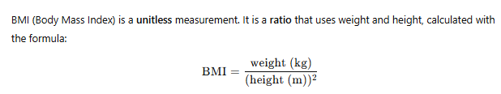
Obesity – what and Why?
Obesity is a medical condition characterized by excessive body fat accumulation that presents a risk to health, typically defined by a Body Mass Index (BMI) of 30 or higher.
obesity significantly increases the risk of chronic diseases like diabetes, heart disease, and certain cancers, impacting individual health and straining healthcare systems.

Slide 4
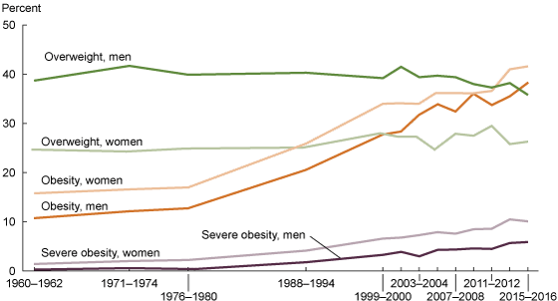
Obesity - trends

Slide 5
Dataset
Source: https://github.com/pymche/Machine-Learning-Obesity- Classification/blob/master/ObesityDataSet_raw_and_data_sinthetic.csv
Participants:
Female: 1043
Male: 1068
Total: 2111

Slide 6
Dataset - Feature Descriptions
Column | Description
Gender | Biological sex of the individual (Male or Female)
Age | Age in years
Height | Height in meters
Weight | Weight in kilograms
family_history_with_overweight | Does the person have a family history of being overweight? (yes/no)
FAVC | Frequent consumption of high-caloric food? (yes/no)
FCVC | Frequency of consumption of vegetables (scale 1–3; higher = more frequent)
NCP | Number of main meals per day
CAEC | Consumption of food between meals (no, Sometimes, Frequently, Always)
SMOKE | Does the person smoke? (yes/no)
CH2O | Daily water intake (in liters)
SCC | Does the person monitor calorie consumption? (yes/no)
FAF | Physical activity frequency (hours per week)
TUE | Time spent using technology devices (hours per day)
CALC | Alcohol consumption frequency (no, Sometimes, Frequently, Always)
MTRANS | Primary transportation method (Walking, Bike, Public_Transportation, etc.)
NObeyesdad | Target variable: obesity level category (e.g., Normal_Weight, Obesity_Type_I, etc.)

Slide 7
categories
Insufficient_Weight
Normal_Weight
Overweight_Level_I
Overweight_Level_II
Obesity_Type_I
Obesity_Type_II
Obesity_Type_III

Slide 8
Original Code (GitHub)
- Did not work properly
- Produced limited number of Plots

Slide 9
New Code
Started with importing few libraries
Made few analysis/calculations
Added plots
Added new analysis
Repaired mistakes

Slide 10
Ideas, analysis, Challenges
After few analysis – separate Male/Female
Dillema: is the difference in number of Male and Female participant (for comparing results)
The difference is negligible (25 e.g. 2,4 % - more Males)
Decision: no action needed
Results have confirmed that that Male/Female data separation added value

Slide 11
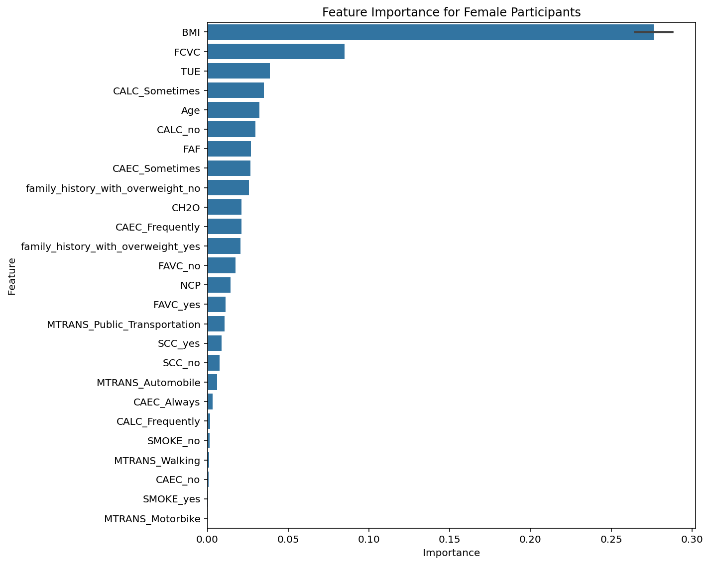
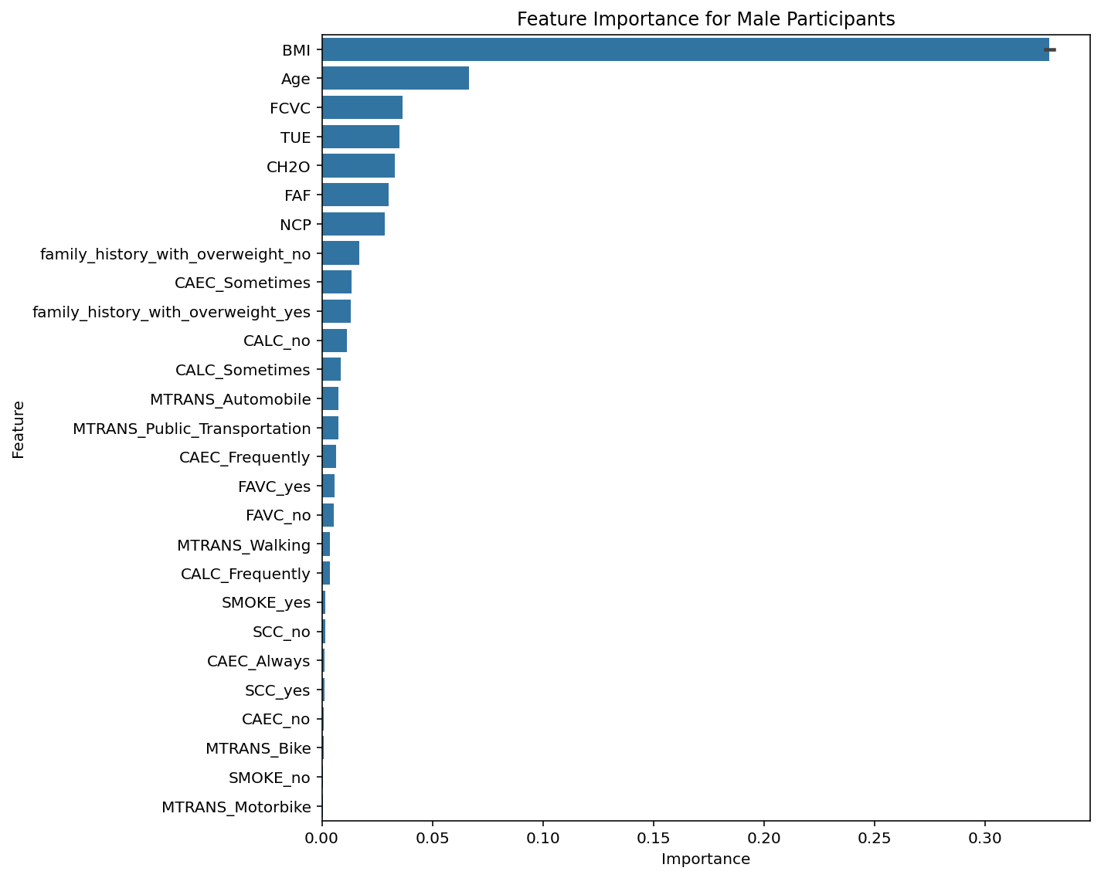
Male/female separation

Slide 12
Ideas, analysis, Challenges
Raw Data suggests that the Weight is the sole parameter to classify person in one of the categories
But I realized soon that it is not even correct, because the Height plays important role
In order to put data under the same common denominator, I have calculated BMI (from Weight and Height) and included BMI as a feature (to in fact replace Weight and Height)

Slide 13
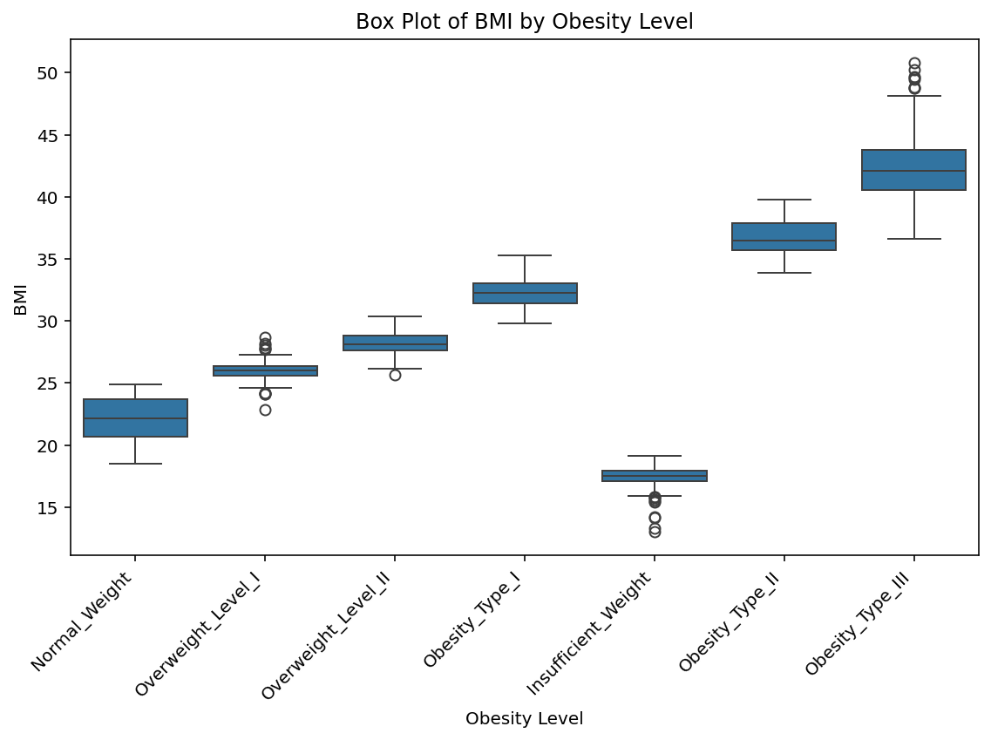
Challenges

Slide 14
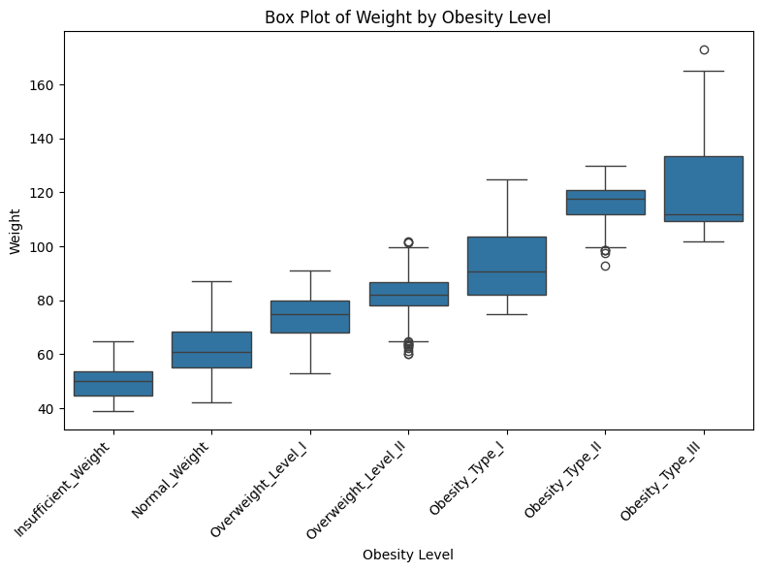
Challenges
# Corrected Code - added
order_list = ['Insufficient_Weight', 'Normal_Weight', 'Overweight_Level_I', 'Overweight_Level_II', 'Obesity_Type_I', 'Obesity_Type_II','Obesity_Type_III’]
# Original Code
plt.figure(figsize=(10, 7))
sns.boxplot(x='Obesity_Class_BMI', y='BMI', data=df)
plt.title('Box Plot of BMI by BMI-based Obesity Class')
plt.xlabel('Obesity Class (BMI)')
plt.ylabel('BMI')
plt.xticks(rotation=45, ha='right')
plt.tight_layout()
plt.show()

Slide 15
Accuracy per model
Model | Accuracy
Decision Tree (depth 1) | 0.72
Decision Tree (depth 3) | 0.99
Decision Tree (depth 5) | 0.98
Logistic Regression | 0.67
SVC (linear, n_estimators=20) | 0.75

Slide 16
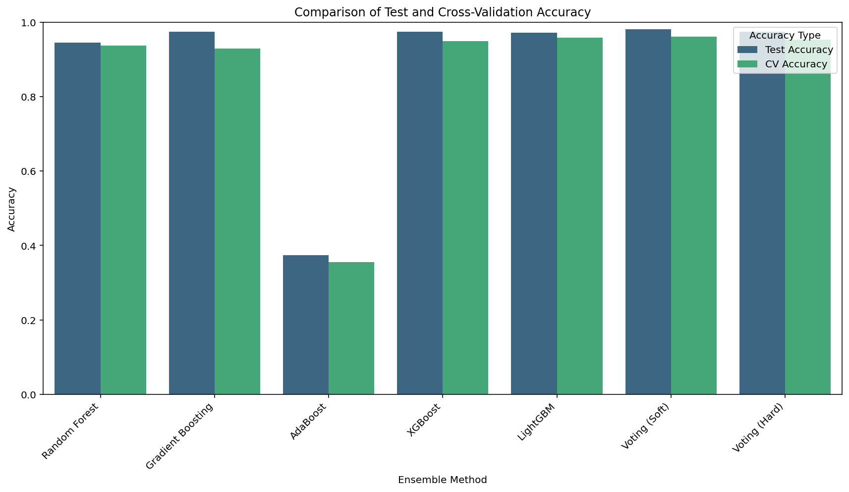
Test vs. Cross-Validation Accuracy

Slide 17
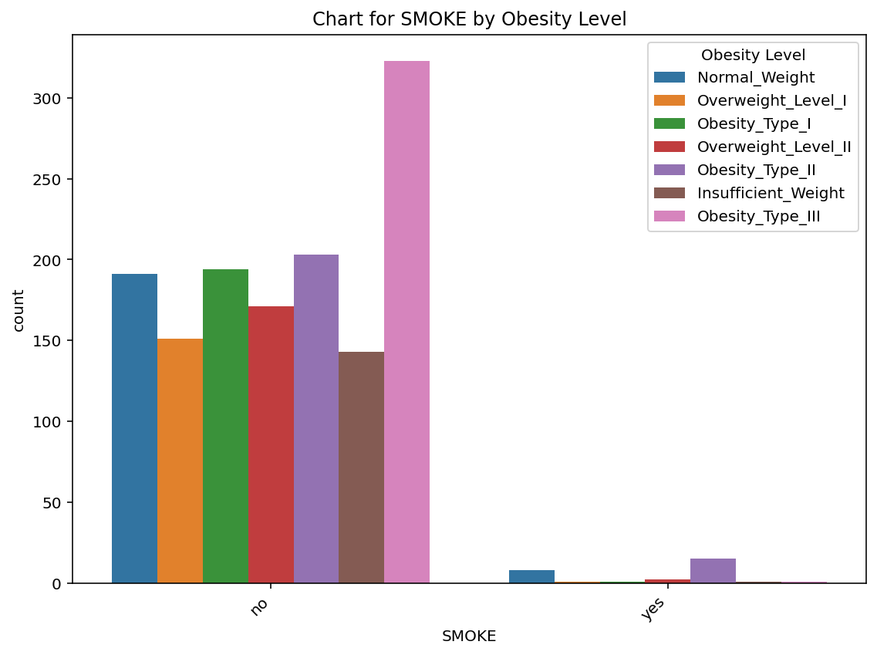
Where is the catch? Total number of participants: 2111 Smokers: 46 Non-smokers: 2068
Don´t let us be tricked by data

Slide 18
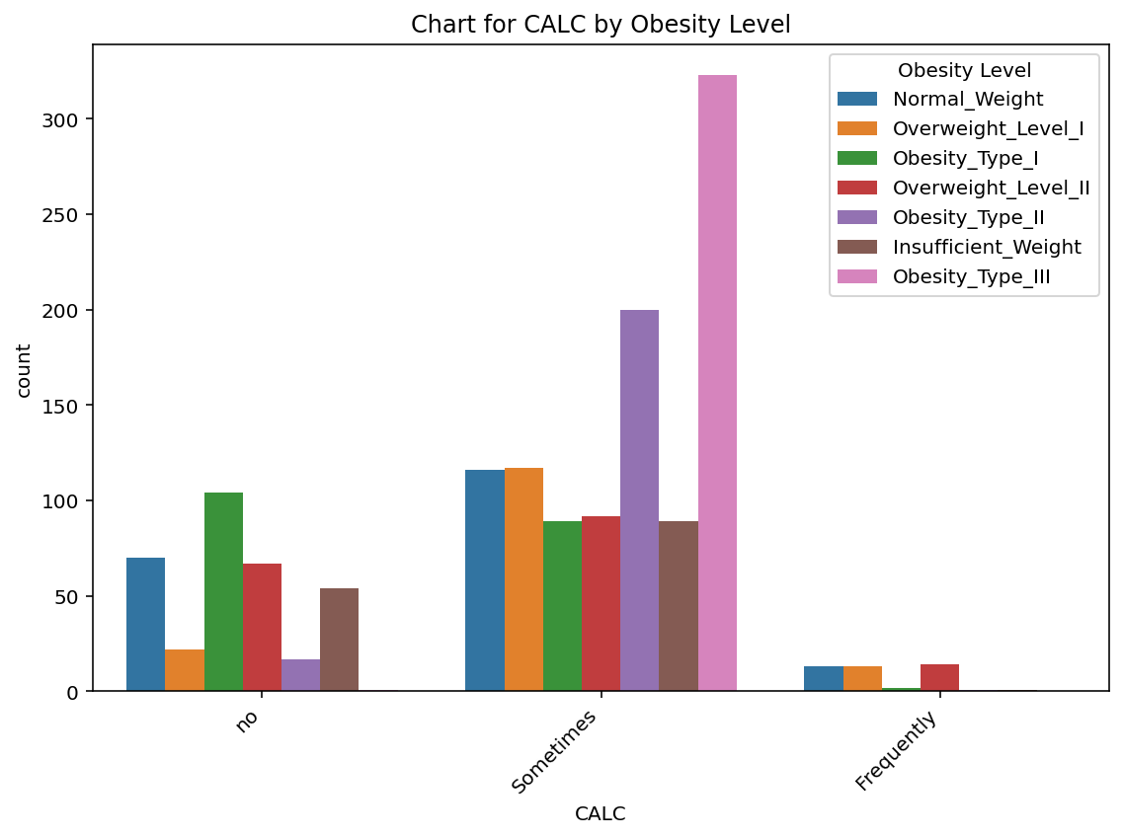
Participants consuming alcohol No: 640 Sometimes: 1402 Frequently: 71
Don´t let us be tricked by data

Slide 19
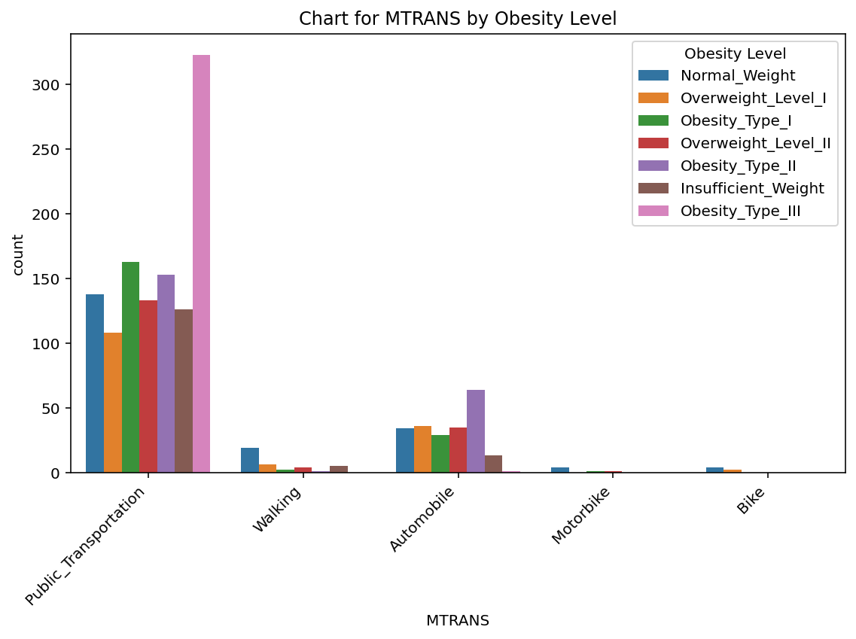
Primary Transportation method public t.: 1581 walking: 57 Automobile: 458 Motorbike: 12 bike: 8
Don´t let us be tricked by data

Slide 20
THANK YOU

